Slide 1

Rule No. 31 of the CMVR
SECTION-J:
VEHICLE MAINTENANCE

Slide 2
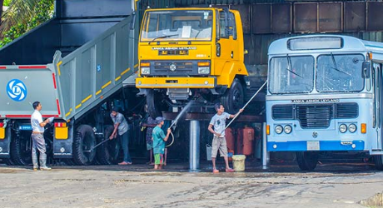
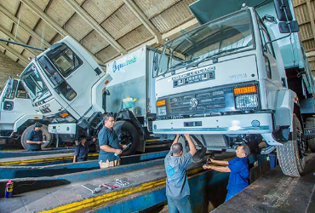
Vehicle Maintenance
Motor vehicle service:
is a series of maintenance procedures carried out at a set time interval or after the vehicle has travelled a certain distance.
The service intervals are specified by the vehicle manufacturer in a service schedule and some modern Vehicles display the due date for the next service electronically on the instrument panel.
The completed services are usually recorded in a service book which is rubber stamped by the service centre upon completion of each service.
A complete service history usually adds to the resale value of a vehicle.
Notes:
Trainer Note:
Trainer to explain what is Vehicle Service
Why is Vehicle Maintenance Required?

Slide 3
Vehicle Maintenance
Scheduling
The actual schedule of Vehicle maintenance varies, depending on the year, make, and model of a Vehicle, its driving conditions and driver behaviour.
Vehicle makers recommend the so-called extreme or the ideal service schedule based on impact parameters such as:
Number of trips and distance travelled per trip per day
Extreme hot or cold climate conditions
Mountainous, dusty or de-iced roads
Heavy stop-and-go vs. long-distance cruising
Towing a trailer or other heavy load
They base it on the driving conditions and behaviour of the Vehicle owner or driver.
Notes:
Trainer Note:
Trainer to explain what is Vehicle maintenance scheduling
Why is Scheduling of Maintenance Required?

Slide 4
Vehicle Maintenance
Common Maintenance tasks carried out during a vehicle service include:
Change the engine oil
Replace the oil / Air / Fuel filters as per schedule by OE manufacturer
Replace the cabin or a/c filter
Service of Fuel Injection system
Check level and refill brake fluid/clutch fluid
Check Brake pads/Liners, Brake discs/Drums, and replace if worn out
Check Coolant & Hoses
Check the charging systems & Battery, if required, replace the battery.
Check level & Refill all Vehicle Fluids - power steering / Automatic,Manual Transmission Fluid
Grease and lubricate components
Inspect and replace the timing belt or timing chain if needed
Check condition of the tyres & periodically Rotate the Tyres
Check for proper operation of all lights, wipers, etc.
Check for any error codes in the ECU/dashboard and take corrective action.
Use a scan tool to read trouble code.
Mechanical parts that may cause the car to cease transmission or prove unsafe for the road are also noted and advised upon.
Notes:
Trainer Note:
Trainer to explain common Maintenance what is Vehicle Service
Why is Vehicle Maintenance Required?

Slide 5
TOPICS
Factors Affecting the Vehicle Parts due to Bad Driving
General day-to-day Maintenance & Periodic Maintenance
Battery Maintenance
Tyre Maintenance & Tube Vulcanising
Engine Tune Up
Checking Wheel Alignment
Brake Adjustment
Accelerator, Brake & Clutch Pedal Adjustment
Fan Belt Adjustment
Observation of Dash Board Meters
Lubrication
Removal of Air Lock & Oil Block

Slide 6
Factors Affecting the Vehicle Parts
due to Bad Driving

Slide 7
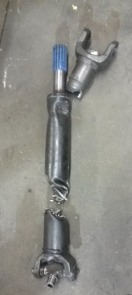
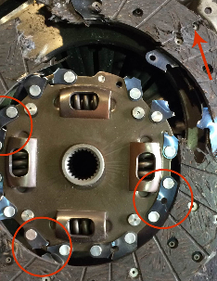
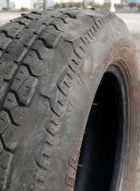
Factors affecting the vehicle parts due to bad & negligent driving
Some Common effects of Vehicle Parts due to Bad Driving:
Excessive wear of tyres during Sudden Braking and Acceleration
Excessive wear & tear of vehicle parts like clutch plate, brake shoes / drums, various bushes & bearings , steering gear box, gear box, propeller shaft ( may break or get bend), breakage of crown wheel and tail pinion, welding of load body may crack etc.
Excessive vibrations in mechanical components.
Suspension problems, breakage and/or bending of shock absorbers, leaf spring issues, axle breakage etc.
Safety of passengers is compromised due to negligent driving
Bad driving may cause Road accidents.
Notes:
Trainer Note:
Trainer to explain with example on some common effects on HMV Parts due to wrong driving Habit.

Slide 8
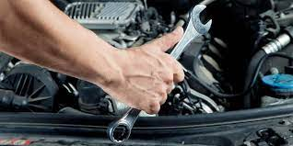
Factors Affecting the Vehicle Parts
due to Bad Driving
Benefits from Good Vehicle Maintenance
Accidents will decrease
Vehicle life will increase
The vehicle will earn more, hence more profit.
Maintenance & repair cost of the vehicle will be less.
Fuel will be saved.
Tyre life will increase.
Less breakdown of the vehicle on the way.
Vehicle will look clean.
The vehicle will reach the destination on time.
Pollution will decrease.
Notes:
Trainer Note:
1. Trainer to stress upon benefits of Good maintenance of HMV

Slide 9
2. General Day-to Day Maintenance
&
Periodic Maintenance

Slide 10
General Day-to Day Maintenance &
Periodic Maintenance
Maintenance is of Two Types :-
Day-to-Day / Daily Maintenance is routine Check-ups done on daily basis like, Tyre air pressure, coolant level, engine oil, level, any leakages, etc.
Scheduled / Periodic Maintenance: as name suggests, it is periodic in nature and done on regular intervals, as mentioned in Operator manual given by OE manufacturer.
Notes:
Trainer Note:
1. Trainer to explain what type of service comes under daily Maintenance & Periodic Maintenance

Slide 11
General Day-to Day Maintenance &
Periodic Maintenance
Daily Maintenance
Some of the Key daily Maintenance / Check points are:-
Fuel Level
Radiator water / Coolant Level
Tyre pressure
Engine oil level
Fan Belt Tension
Wheel nut, Joint Nuts, Axle nuts & Steering Nut tightness
Battery connections
Clean front and rear glass
Check Oil leak/ diesel leak/ Air leak & any Vehicle fluid leaks
Check steering joints, cab & body
Check All Lights (Head/Rear/etc.), Wiper motor, indicator & horn,
Check Brake, Clutch Pedal play
Check Instrument Panel with all tell tales
Check ad-blue level & all fuses
Loose Body Parts / damages (dent, etc.)
Notes:
Trainer Note:
Trainer to explain Key points to check in daily check-up maintanence.

Slide 12
General Day-to Day Maintenance &
Periodic Maintenance
Scheduled / Periodic Maintenance of Vehicle service include:-
Changing the oils– Engine, Gear Box, Rear Axle etc.
Replacing the filters – oil , air, fuel, cabin etc.
Calibration of FIP & Injectors, if necessary, replace the injectors as recommended
Tuning up of the engine– tappet setting etc.
Check level and refill the fluids --brake /clutch / steering systems
Free Play adjustment of accelerator /brake / clutch pedals, wheel hubs, thrust pad
Check Brake Pads/Liners, Brake Discs/Drums, and replace if worn out.
Check level and refill Automatic/Manual Transmission Fluid
Greasing of joints ( ball joints/UJ cross) & linkages , and lubricate components
Hub Greasing –Front and rear
Inspect and replace the timing belt or timing chain if needed
Check condition of the tires, wheel balancing and wheel alignment
Check for proper operation of all lights, wipers, other electrical & electronic parts etc.
Check for any Error codes in the ECU and take corrective action.
Wash the vehicle and clean the interiors.
Mechanical parts that may cause the Vehicle to cease transmission or prove unsafe for the road are also noted and advised upon.
Notes:
Trainer Note:
Trainer to tell about Periodic maintenance
Trainer to stress upon for taking vehicle for service to Authorized Service Center only and use only Genuine OE Parts.

Slide 13
General Day-to Day Maintenance &
Periodic Maintenance
Sample: Typical Service Schedule: Service Schedule varies from OE manufacturer to manufacturer as well as from model to model.
Notes:
Trainer Note:
Trainer to just tell that Maintenance schedule differs from model to model as well as from manufacturer to manufacturer by giving examples. Tata Truck will have different schedule then Leyland Vehicles.
Will Captain and U Truck of Ashok Leyland have same service schedule? (Ans. NO)

Slide 14
General Day-to Day Maintenance &
Periodic Maintenance
Example: Consumables - Change period: Service Schedule varies from OE manufacturer to manufacturer as well as from model to model.
Notes:
Trainer Note:
Trainer to just tell that consumable change periodic & quantity schedule differs from model to model as well as from manufacturer to manufacturer by giving examples. Tata Truck will have different schedule then Leyland Vehicles.
The same has to be changed as per operator manual given by OEM.
Always use Genuine Oils & consumables only.
Will Captain and U Truck of Ashok Leyland have same Oil quantity and change schedule? (Ans. NO)

Slide 15
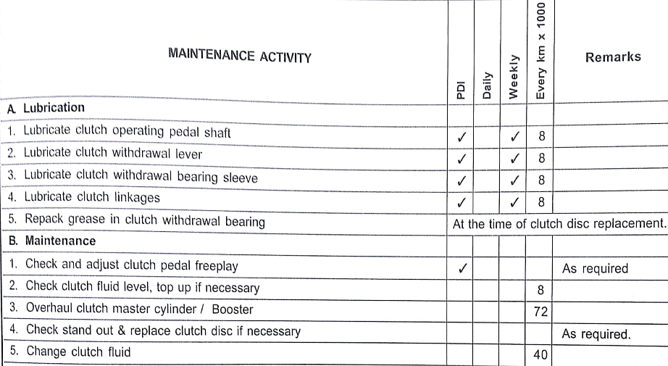
General Day-to Day Maintenance &
Periodic Maintenance
Typical Maintenance Schedule
Notes:
Trainer Note:
Trainer to just tell with example of chart on Maintenance schedule.

Slide 16
3. Battery Maintenance

Slide 17
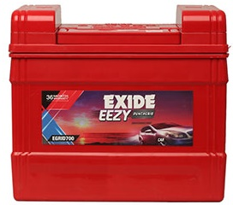
Battery Maintenance
Battery:
It is a device consisting of one or more electrochemical cells with external connections provided to power electrical circuits/components of a Automobile.
Batteries convert chemical energy directly to electrical energy. A battery consists of some number of voltaic cells
The electrical energy generated by Alternator is stored in a Battery for use when the engine is not running. Battery stores the energy in an electro-chemical form.
While starting the vehicle, starter motor takes electrical energy from the battery.
-ve Terminal
+ve Terminal
BATTERY
Notes:
Trainer Notes:
Trainer to explain that and consumption of battery charge for starting of the Vehicle is recharged by alternator after vehicle starts.
Trainer to explain usage of petroleum Jelly at terminals and check distilled water levels on regular intervals
Trainer to brief on various Battery types available.
Question: Which water to put in Battery? (a distilled water; b, soda water; c, tap Water; d, acid)
To maintain time gap of 60 Seconds between two alternate cranking of engine.

Slide 18
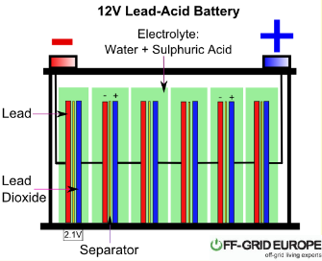
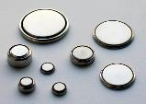
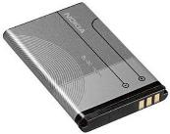
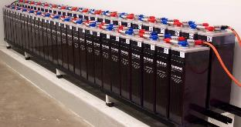
Battery Maintenance
Batteries Types:
Primary batteries are designed to be used until exhausted of energy & discarded.
Secondary batteries can be used & recharged; they can have their chemical reactions reversed by applying electric current to the cell.
Batteries Usage:
come in many shapes and sizes & have many applications.
in miniature cells used to power hearing aids, wristwatches
Small, thin cells used in smart phones, etc.
Large lead acid batteries used in Automobiles, EV Vehicles.
At the largest extreme, huge battery banks, the size of rooms that provide standby or emergency power for telephone exchanges, data centres, etc.
Notes:
Trainer Notes:
Trainer to briefly tell difference in Chargeable and non chargeable batteries
Trainer to explain various Usage of Batteries.

Slide 19
Battery Maintenance
Battery Maintenance
It is very important to keep the battery maintained as all electrical circuits/ aggregates start with Battery.
New Battery should be fully charged before use
The battery should be clean.
Cable connection needs to be clean and tightened.
Many battery problems are caused by dirty and loose connections.
Serviceable battery needs to have the electrolyte level checked regularly and top up if necessary.
Check the Specific Gravity of the electrolyte with a hydrometer.
Always use Distilled water & avoid tap water as it is loaded with chemicals and minerals that are harmful to your battery.
Don't overfill battery cells especially in warmer weather.
Check the Battery Voltage regularly. Do the bench charging if required.
Vent Caps should be fully tight and kept in clean state
Coat the washer with high temperature grease or petroleum jelly (Vaseline).
Notes:
Trainer Note:
What is the important steps in battery maintenance.
Trainer to tell that terminals should be coated with only petroleum Jelly and NO Grease to be used.
Heavy Vehicles mostly operate on 24V system, whereas Cars operate on 12 V system

Slide 20
4. Tyre Maintenance

Slide 21
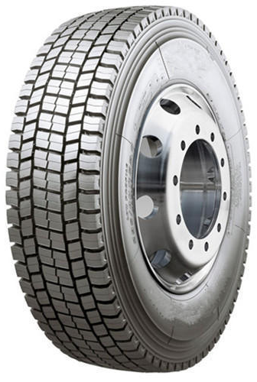
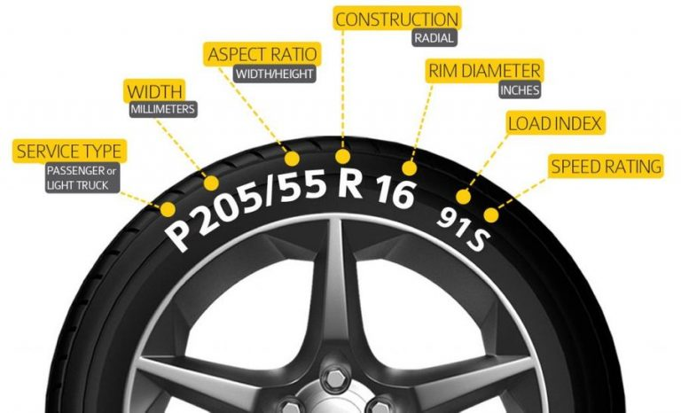
Tyre Maintenance
Key points for Tyre Maintenance are:
Checking Regular Tyre Pressure
Check the tyres for any cut , wear pattern etc.
Rotate the tyres as recommended by the manufacturer
Retread the tyres , if necessary
Notes:
Trainer Note:
1. Trainer to explain the Key points of Tyre Maintenance.

Slide 22
Tyre Maintenance
Tyre Pressure
Recommended Pressure:
Maintain the air pressure in the tyres of the vehicle as recommended by the manufacturer for the best performance of the vehicle.
Do not over / under inflate the tyres.
Over inflated tyres may cause excessive wear of tyre from centre
Under inflated Tyres may cause excessive wear of tyre from sides
Loss of Pressure:
Small loss of pressure takes place regularly not due to any defect, but on account of normal diffusion of oxygen through the tube material.
However, pressure loss of more than 5 pounds (35 kpa) in a week may be due to faulty valve, leaking patch or even some puncture.
In this case, one should get the tyre checked.
Normal Air is recommended for HMV tyres, whereas now-a-days, Car users are switching to Nitrogen filled tyres.
As Nitrogen is cold inert gas, hence tyre will operate on cooler conditions, thereby life is improved.
Notes:
Trainer Note:
1. Trainer to explain on benefits of maintaining right tyre pressure

Slide 23
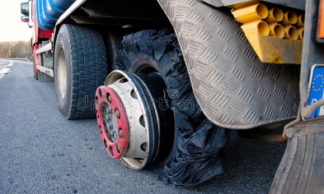
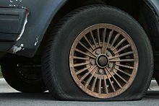
Tyre Maintenance
Flat Tyre: occurs when a tyre deflates.
Occurs as a result of normal wear-and-tear, a leak, or more serious damage.
A tyre that has lost sufficient pressure will impair the stability of the vehicle and may damage the tyre further if it is driven in this condition.
The tyre should be changed and/or repaired before it becomes completely flat.
Continuing to drive a vehicle with a flat tyre will damage the tyre beyond repair, possibly damage the rim and vehicle, and put the occupants and other vehicles in danger.
It is always beneficial to replace worn out tyres in time.
Driver should find a flat part of the FIRM road, on left side, before changing tyre as Wheel jack may slip otherwise.
Notes:
Trainer Note:
Trainer to explain harm on driving with flat Tyres.
Trainer to explain that vehicle to be brought to left side of the road before replacing the tyre.

Slide 24
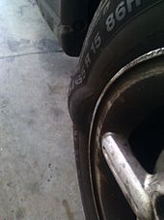
Tyre Maintenance
Tyre Bubble:
Tire bubbles, also referred to as bulges / bumps / protrusions / Vehicle bungles, occur when the sidewall of the tire has failed, resulting in a protrusion.
Causes of bubbles include having an impact at high speed, over inflation, or poor tire construction/manufacturing.
It is generally recommended to replace the tire since the probability of tire failure has increased.
Notes:
Trainer Note:
1. Driver to observe from time to time for any tyre bubbles as it can lead to tyre brust.

Slide 25
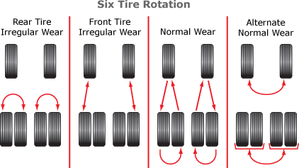
Tyre Maintenance
Importance of Tyre Rotation:
Tyre rotation is moving the tyres to different Vehicle positions, such as front-to-rear, in order to even out the wear, with the objective of extending the life of the tyre
Tires may exhibit irregular wear patterns once installed on a vehicle and partially worn.
Front-wheel drive vehicles tend to wear the front tires at a greater rate compared to the rear tires.
Notes:
Trainer Notes:
Trainer to tell on Tyre rotation cycle and why it is important
Tyre rotation is based on the Vehicle make and Model and to abide to OEM operator manual

Slide 26
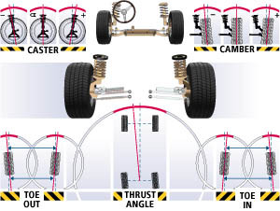
Tyre Maintenance
Wheel Alignment:
Wheel alignment is the procedure for checking and correcting this condition through adjustment of camber, caster and toe angles.
Wheel and tyre may not be perfectly aligned to the direction of travel, and therefore may exhibit irregular wear.
If the discrepancy in alignment is large, then the irregular wear will become substantial if left uncorrected.
The adjustment of the angles should be done as per the OEM specifications.
Notes:
Trainer Note:
Trainer to tell on importance of Wheel alignment and safety enhancement with well aligned wheels
Trainer to explain and stress on to follow Wheel alignment schedule as it increase life of tyres as well as safety.

Slide 27
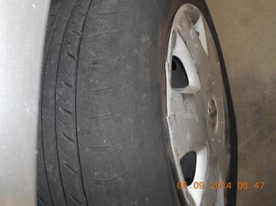
Tyre Maintenance
Tyre Wear: Most common troubles occurring on account of wheels and tyres are:-
Side wear of tyre:
When the tyre tread wear more at the sides than at the centre, it is due to low tyre pressure or repeat high speed cornering.
One side wear of tyres:
This may be due to incorrect camber angle or incorrect toe in or sagging axle on account of overloading.
Continuous running on highly cambered roads may also result in this type of wear.
Notes:
Trainer Note:
1. Trainer to explain what is tyre wear and various types / reasons of tyre wear as per pattern left on worn tyre

Slide 28
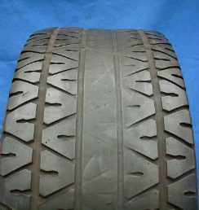
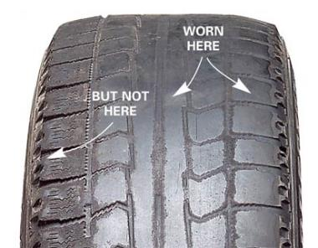
Tyre Maintenance
Centre wear of tyre tread:
The reason for this is the high tyre pressure.
Uneven tyre wear:
This is due to buckled wheel or the tyre and wheel assembly being out of balance.
Sudden acceleration and braking also result in this type of wear.
Notes:
Trainer Note:
1. Trainer to explain what is tyre wear and various types / reasons of tyre wear as per pattern left on worn tyre

Slide 29
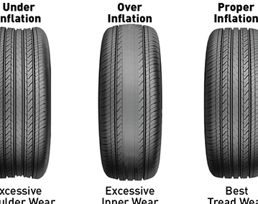
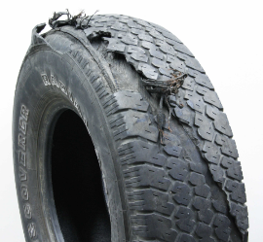
Tyre Maintenance
Uniform rapid wear:
Driving on rough roads or fast driving are the cause of the uniform but rapid wear.
It is estimated that wear of tyre at a speed of 80 kph Is approximately twice than at a speed of 50 kph.
Tread or ply separation:
This may be caused by overloading, excessive or insufficient air pressure, high speed or impact.
Small trade cuts when neglected may also lead to this trouble.
Notes:
Trainer Note:
Trainer to explain various types of wears of tyre.
Trainer to stress that Air pressure in tyre varies from vehicle to vehicle as well as from Load to load.

Slide 30
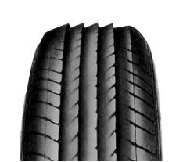
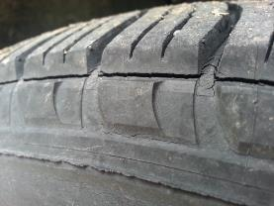
Tyre Maintenance
Rapid wear with feathered edge on the tread:
This type of wear may be detected by placing finger on the tread and moving slowly in the cross direction, first on one side and then on the other side.
This mean the tyre has also been skidding. This may be due to incorrect alignment.
On rear axle this may be due to on misalignment of chassis and displacement of axle.
Tread cracking:
This is due to overloading, over inflation or under inflation.
Notes:
Trainer Note:
1. Trainer to explain on Rapid wear & Tread cracking

Slide 31
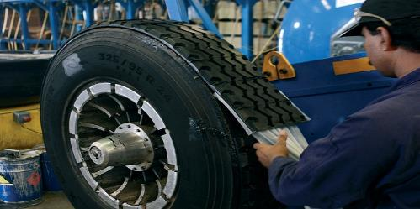
RETREADING PROCESS
Tires that are fully worn can be re-manufactured to replace the worn tread.
This is known as retreading or recapping, a process of buffing away the worn tread and applying a new tread.
Retreading is economical for truck tires because the cost of replacing the tread is less than the price of a new tire.
Retreading passenger tires is less economical because the cost of retreading is high compared to the price of new cheap tires, but favourable compared to high-end brands.

Slide 32
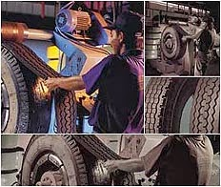
RETREADING PROCESS
Worn tires can be retreaded by two methods, the mold or hot cure method and the pre-cure or cold one.
The mold cure method involves the application of raw rubber on the previously buffed and prepared casing, which is later cured in matrices.
During the curing period, vulcanization takes place and the raw rubber bonds to the casing, taking the tread shape of the matrix.
On the other hand, the pre-cure method involves the application of a ready-made tread band on the buffed and prepared casing, which later is cured in an autoclave so that vulcanization can occur.

Slide 33
Tyre - Safety
Proper vehicle safety requires specific attention to inflation pressure, tread depth, and general condition of the tires.
Over-inflated tires run the risk of explosive decompression (they may pop)
Under-inflated tires have a higher rolling resistance and suffer from overheating and rapid tread wear particularly on the edges of the tread.
As tire tread decreases, there is more traction between the tire and the road resulting in better grip. However, there is an increased risk of hydroplaning, so as the tire wears the performance in the dry generally improves, but gets worse in the wet.
Tires worn down past their safety margins and into the casing run the very real risk of rupturing.
Certain combinations of cross ply and radial tires on different wheels of the same vehicle can lead to vehicle instability, and may also be illegal.
Vehicle and tire manufacturers provide owners' manuals with instructions on how to check and maintain tires.
Notes:
Trainer Note:
1. Trainer to explain on Tyre Safety and common dos and donts.

Slide 34
5.Engine Tune Up

Slide 35
Engine Tune Up
Tune Up Basics: Simple steps to doing a tune-up on a truck:
Changing the air filter – when it is clogged or as per maintenance schedule.
Cleaning / Changing the Fuel Injectors
Checking fuel lines for any leakages etc.
Checking the Fuel Injection Pump
Changing the engine oil
Valve clearance / lashes adjustment
Checking various moving parts externally
Carrying out adjustment jobs as per maintenance schedule
Checking any leakages of oil, coolant & Topping up the fluids, etc.
Checking the cylinder compression using a guage.
Checking and tightening of various nuts & bolts
Checking different pulleys & belts etc.
Checking and draining of water separator
Changing the fuel filters
Calibrating the Fuel Injectors with appropriate nozzle opening pressure
Checking fuel tank and its suction filters
Checking the Injection timing
Checking the KSB Solenoids
Checking the ECU for any engine faults and rectifying the same
Notes:
Trainer Note:
1. Trainer to explain in a very simple way on Engine Tune Up Basics.

Slide 36
6. Checking Wheel Alignment

Slide 37
Checking Wheel Alignment
Wheel Alignment: Sometimes referred to as breaking or tracking, is part of standard automobile maintenance that consists of adjusting the angles of wheels so that they are parallel to each other and perpendicular to the ground.
The purpose of these adjustments is to reduce tire wear, and to ensure that vehicle travel is straight and true (without "pulling" to one side).
Wheel alignment is the procedure for checking and correcting this condition through adjustment of camber, caster and toe angles.
Wheel and tyre may not be perfectly aligned to the direction of travel, and therefore may exhibit irregular wear.
Notes:
Trainer Note:
Trainer to tell on importance of Wheel alignment and safety enhancement with well aligned wheels
Trainer to tell that Driver to check if the Alignment machine has updated with latest readings for the model as recommended by OEM.
Trainer to explain and stress on to follow Wheel alignment schedule as it increase life of tyres as well as safety.

Slide 38
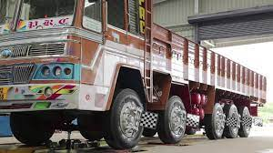
Checking Wheel Alignment
Wheel Alignment Contd.:
If the discrepancy in alignment is large, then the irregular wear will become substantial if left uncorrected.
The adjustment of the angles should be done as per the OEM specifications.
Alignment angles can also be altered beyond the maker's specifications to obtain a specific handling characteristic.
Notes:
Trainer Note:
Trainer to tell on importance of Wheel alignment and safety enhancement with well aligned wheels
Wheel alignment to be done for all the Wheels of the HMV.

Slide 39
Checking Wheel Alignment
Sample Wheel Alignment report:
Notes:
Trainer Note:
Trainer to show and explain sample of Wheel alignment report.
Wheel alignment of Vehicle to be done in empty condition only.

Slide 40
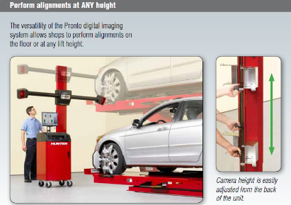
Checking Wheel Alignment
Measurement:
A camera unit (sometimes called a "head") is attached to a specially designed clamp which holds on to a wheel.
There are usually four camera units in a wheel alignment system (a camera unit for each wheel).
The camera units communicate their physical positioning with respect to other camera units to a central computer which calculates and displays.
Often with alignment equipment, these "heads" can be a large precision reflector.
Alignment "tower" contains the cameras as well as arrays of LEDs. This system flashes one array of LEDs for each reflector whilst a camera centrally located in the LED array "looks for" an image of the reflectors patterned face.
Notes:
Trainer Note:
1. Trainer to explain briefly how Wheel alignment is done.

Slide 41
Checking Wheel Alignment
Sample of Typical Wheel Alignment service schedule of some truck models:
Notes:
Trainer Note:
1. Trainer to tell that may tyre manufacturers approve Tyre warranty if Wheel alignment schedule is followed.

Slide 42
7. Brake Adjustment & Defects

Slide 43
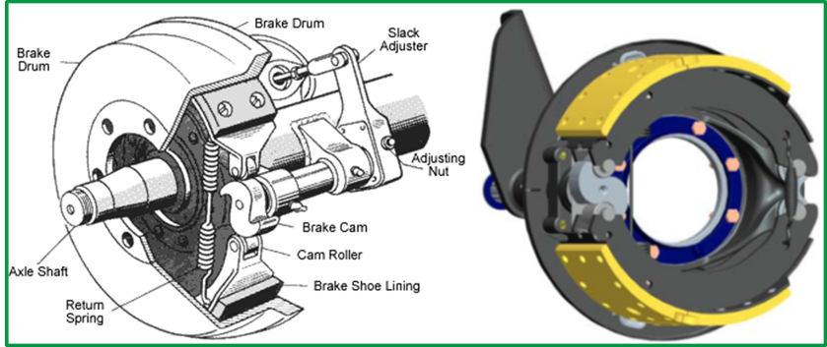
Brake Adjustment & Defects
Brake Adjustments:
S-CAM brake systems have been used in medium and heavy trucks for decades.
Many S-CAM brakes are non-self adjusting and therefore require periodic readjusting to compensate for brake shoe wear.
Slack Adjuster automatically adjusts the gap between Brake Liner & Drum
In auto Slack Adjuster type Brake system, adjustment is only required at the time of Brake Pad replacement.
Notes:
Trainer Note:
Latest Vehicles are fitted with Auto slack Adjusters – No need of Brake setting frequently

Slide 44
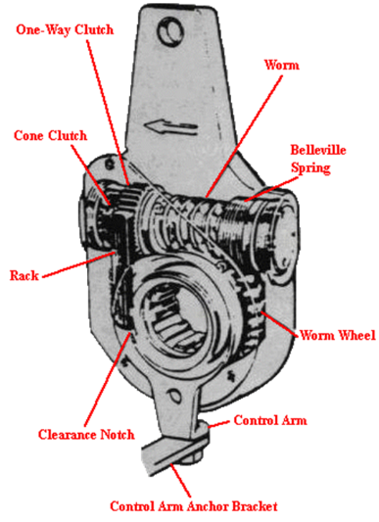
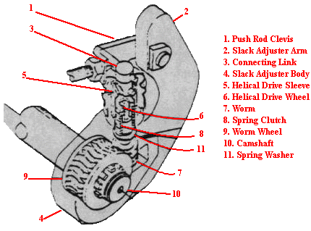
Brake Adjustment & Defects
Auto Slack Adjuster
Manual Slack Adjuster
Notes:
Trainer Note:
1. Trainer to explain on slack adjuster

Slide 45
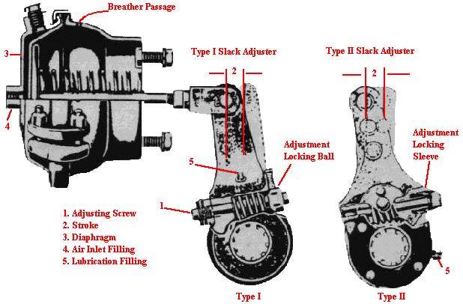
Brake Adjustment & Defects
Types of Auto Slack Adjuster
Notes:
Trainer Note:
1. Trainer to explain very briefly just that there are two types of Slack Adjusters.

Slide 46
Brake Adjustment & Defects
Brake Adjustment:
An S-CAM brake with excessive shoe to drum clearance will engage too late while one which is too tight will engage too soon and may drag.
This drag can reduce KMPL & result in premature brake shoe and/or drum wear.
It is critical for both safety and maximum fuel economy that S-CAM brakes be properly adjusted.
It is important to note that all S-CAM brakes on a given vehicle to be adjusted properly to avoid undue improper rear to front synchronization.
Trailer brake adjustment on fifth wheel units is also important to synchronization and lateral force equalization.
A broken Return spring or a return spring that has lost its tension will cause a brake shoe to drag.
Excessive corrosion or lack of proper lubrication of the shoe mount and shoe to backing plate may also cause an S-CAM shoe to drag.
Dragging shoe can cause reduced KMPL and premature shoe wear.
Notes:
Trainer Note:
1. Trainer to explain on importance on Brake adjustment.

Slide 47
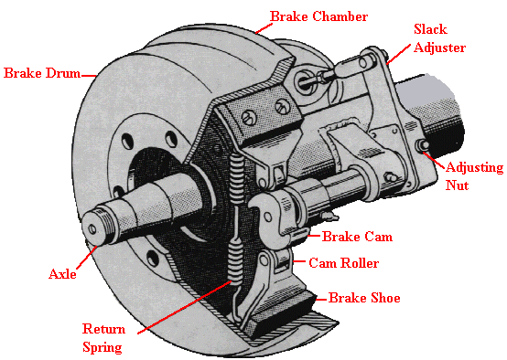
Brake Adjustment & Defects
Brake adjustment: Figure-A illustrates a typical S-CAM brake. The adjusting nut allows the shoe to be positioned closer or farther from the brake drum.
Figure-A : S-CAM Brake
Notes:
Trainer Note:
1. Trainer to just show the figure so that driver understands.

Slide 48
Brake Adjustment & Defects
Brake Adjustment Process:
Locate an appropriate manual to determine correct adjustment procedure.
Block the wheels so the vehicle will not roll.
Release the parking brake and place transmission in neutral.
Raise the axle and place a safety stand at an appropriate place to support the weight of the vehicle.
By hand, try to rotate wheel and tire assembly. If it moves freely, check for:
Proper stroke or travel of the slack adjuster, usually 1 - 1 1/2 inches.
Correct decrease of air tank pressure for a full brake application - usually 8 to 12 psi.
The slack adjuster set at 90° to the brake chamber with full brake application.
If any of these adjustments are out of specifications, readjust according to manufacturer's specification.
If the wheel and tire assembly does not turn freely, recheck the adjustments. If the wheel still does not turn freely, remove the brake drum for an internal inspection.
Notes:
Trainer Note:
Trainer to explain process of Brake adjustment

Slide 49
Brake Adjustment & Defects
Brake System – Trouble shooting
Loss of brake efficiency:
The brake fluid may have leaked and entered the brake drum and soaked the brake lining. The lining has to replaced in such a case and the source of leak repaired.
The pressure of air in the system which has to be bled. Also, the source of air entry should be detected and repaired.
The brake lining may have worn smooth. This has to be replaced.
Operating linkage of the brake system may be out of adjustment or disconnected which may be adjusted or reconnected.
Automatic Brake adjuster may have stopped functioning which may be inspected, repaired or replaced as required, after which brake shoe may be adjusted.
Brake shoe may be distorted, which may be replaced.
Brake drum may be too thin or cracked in either case it has to be replaced
The master cylinder may be defective, which may be overhauled.
Broken lines, which may be detected and replaced or rectify.
Notes:
Trainer Note:
1. Trainer to explain the Trouble shootings in Brake System

Slide 50
Brake Adjustment & Defects
Brake System – Trouble shooting
Brake fade: This may be on account of any or more of the following reasons:
Brake fluid may have deteriorated with use. The same may be flushed out, fresh fluid or correct specifications filled in and the system bled.
Poor contact between brake lining and the drum. The shoe may be ground to correct radius and/or adjusted
The brakes may be dragging. In such a case, the appropriate cause of defect has to be investigated and remedy provided.
the brakes may have been excessively used. If so, reduce speed/ load and use lower gears. This may help to cool down the brakes
Brakes Binding: In mechanical brakes, binding or dragging may be caused by:
The brake shoe retracting springs or the pedal return spring may be weak or broken, which should be replaced
The brake shoe may be jammed over the anchor pin, which shoub be lubricated
Parking brake may be too tight, which may be adjusted.
Parking brake may not get released. The brake linkage may be cleaned, lubricated & adjusted.
Notes:
Trainer Note:
1. Trainer to explain the Trouble shootings in Brake System

Slide 51
Brake Adjustment & Defects
Brake System – Trouble shooting: In case of hydraulic brakes, apart from the above reason the defect may be due to following more causes:
Incorrect free pedal. To remove defect in the pedal, free play should be adjusted as given in the Workshop manual of the particular vehicle.
By-pass port in the master cylinder might have been blocked, which may be cleaned properly, filled with fresh brake fluid and bled. Wire or drill never should be used for the purpose.
Replacement Piston cup in master cylinder or wheel cylinder, if found swollen.
The fluid level in the master cylinder may be excessive which may be rectified or the vent hole in the cover of master cylinder may be clogged which may be cleaned.
If however, only one brake is binding or dragging, it may be due to:
Brake shoe on the particular wheel may require readjustment.
Replace Retractor Spring on the wheel as it may have become weak
Replace/ repair Wheel cylinder as it may have become defective.
Notes:
Trainer Note:
1. Trainer to explain the Trouble shootings in Brake System

Slide 52
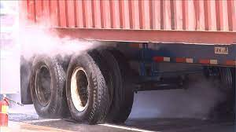
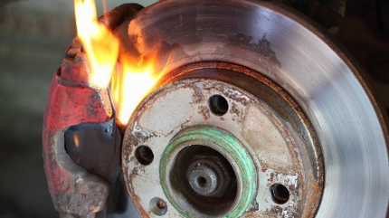
Brake Adjustment & Defects
Brake System – Trouble shooting:
Brakes Overheating
The overheating of the brakes is most likely due to the same reason as for brakes binding /fade.
Apart from these, they may occur also after prolonged use of brakes while descending a hill.
In case of disc brakes apart from the above, the piston in the calliper may be seized.
To remedy this, the calliper has to be re bored and the piston replaced.
Notes:
Trainer Note:
1. Trainer to explain the Trouble shootings in Brake System

Slide 53
Brake Adjustment & Defects
Brake System – Trouble shooting:
Brakes Judder/Vibration
This may be either due to wrong brake adjustment, which may be corrected,
Or due to the brake lining rivets being loose, in which case the lining has to be attached again with new rivets. In most of cases the lining also has to be replaced
Vehicle pulling to one side when brakes applied:This defect may arise on account of the following reasons:
one or more brakes may be incorrectly adjusted. Rectify by correct adjustment.
If a compensator is used in the brake system. The same might have became defective, which should be inspected and the defect removed.
The oil or grease might have entered one or more drums. Which puts more load on clean linings. The wet lining have to be replaced to remedy the defect. The cause of the enter of oil into the drum should also be investigated and remedied, like too high level of lubrications in the rear axle, etc.
This defect may also be due to fitting of different lining on different individual shoes. The only remedy is to remove such different linings and replace these by the lining similar to those used on other shoes.
Notes:
Trainer Note:
1. Trainer to explain the Trouble shootings in Brake System

Slide 54
Brake Adjustment & Defects
Brake System – Trouble shooting:
Vehicle pulling to one side when brakes applied: This defect may arise on account of the following reasons:
The dust etc. might have entered the brakes, plugging some brake line, in which case they be cleaned.
Uneven tyre pressure may be the cause which may be corrected by inflating all tyres to the specified pressure.
Front end alignment may not be correct, which may be done properly
Some suspension spring may be weak, sagging or broken which has to be replaced.
Some shock absorber may be weak, which may be replaced.
In case of the disc brake, this defect may arise on account of following reasons:
The brakes pad may not be similar on all the wheels; replace defective ones
Oil or grease might have entered the brake pads. The wet pads to be replaced and the cause of leakage of oil, grease should also be checked & repaired.
The piston in any one brake may have seized, which should be remedied by turning the calliper and installing new piston.
Notes:
Trainer Note:
1. Trainer to explain the Trouble shootings in Brake System

Slide 55
Brake Adjustment & Defects
Brake System – Trouble shooting:
Grabbing Brakes:
If the brakes are too sensitive or grab, the following may be the reason:
Brake lining may be greasy or brake fluid may have leaked on it. To be replaced.
Brake shoe may not be properly adjusted which may be done.
Brake plate may be loose, which may be tightened.
Brake drum may be scoured which will have to be turned or ground. If already
ground to maximum limits, the drum has to be replaced.
Brake lining may be charred. If so, the shoes have to be relined.
Brake lining may be loose on shoes, in which case same has to be replaced.
Wheel bearing may be loose, which may be adjusted.
Wheel bearing may be defective. If so, the same may be replaced.
Dirt or dust may have entered the brake shoe assembly. The same may be disassemble and cleaned.
Primary and secondary shoes may have been reversed. The same may be reinstalled correctly.
Notes:
Trainer Note:
1. Trainer to explain the Trouble shootings in Brake System

Slide 56
Brake Adjustment & Defects
Brake System – Trouble shooting:
Hand Brakes ineffective:
The usual reason for this defect is the stretching of the operating cable, which can be adjusted with the help of the means provided for this purpose.
Generally a nut is provided, at the end of the lever (Hindustan ambassador). Replace the cable, in case it is still slack, even after full adjustment.
Excessive loss of brake fluid: This may be due to:
Leaking of master cylinder or wheel cylinder, which can be inspected and repaired or replaced as necessary.
Any connection may be loose, which can be tightened properly.
Connecting pipe or hose may be damaged, which has to be replaced.
Presence of air in the braking system: This may be on account of the following:
Master cylinder may have some defects causing the leak of air inside. The same may be repaired or replaced if required.
Any connection may loose, which can be tightened properly.
Notes:
Trainer Note:
1. Trainer to explain the Trouble shootings in Brake System

Slide 57
8. Accelerator, Brake & Clutch Pedal Adjustment

Slide 58
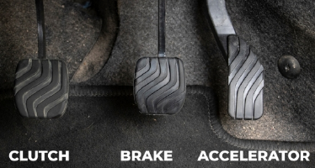
Accelerator Pedal
Accelerator Pedals: are mainly used for achieving the desired speed of the vehicle; by the drivers.
Two Main Types :- Mechanical & Electronic
While the Electronic Accelerator Pedal Modules ( APMs) are being fitted in the new age vehicles ( BS-III onwards ), Mechanical Accelerator Pedals were fitted in the vehicles prior to BS-III norms.
Electronic APMs do not need any kind of adjustment, whereas, Mechanical pedals are to be adjusted periodically to get the best performance from the vehicle.
Mechanical Accelerator Pedals are normally connected through linkages / ball joints to the engine which need to be adjusted and lubricated periodically.
Generally OEMs give a free play of 5-6mm in mechanical accelerator pedals.
Free play needs to be maintained to get good performance from the vehicle.
Notes:
Trainer Note:
Trainer to explain the accelerator Pedal and its function
Trainer to explain on difference between mechanical & Electronic Pedal

Slide 59
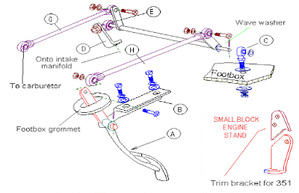
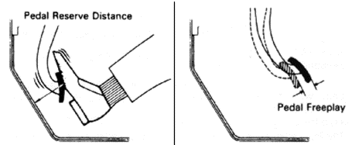
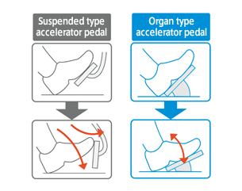
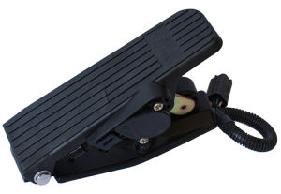
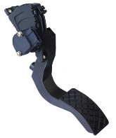
Accelerator Pedal
Mechanical Accelerator Pedal
Electronic Accelerator Pedal
Accelerator Pedal Location
Notes:
Trainer Note:
Trainer to explain on Pedal types
Trainer to explain on Electronic Pedal type -

Slide 60
Brake Pedal- Adjustment
Notes:
Trainer Note:
1. Trainer to explain on Brake Pedal adjustment

Slide 61
Clutch Adjustment
Clutch Free Play Adjustment:
The initial clutch pedal free play is to be set at 2.5” with new disc.
As the disc wear off, the clutch pedal free play gets reduced.
When the pedal play reduces to 0.5”, loosen the lock nut at clutch lever jaw end and gearbox sleeve end, reduce the clutch rod length & set the free play to 2.5”
Continue to run the vehicle till free play reduces to 0.5”. At this condition, again loosen the lock nut at clutch lever jaw end & gearbox sleeve end, reduce the clutch rod length, set the free pedal to 2.5”. Continue to run the vehicle till the free pedal reduces to 0.5”
Now, reverse the pressure the pads (4 nos.) in the clutch cover assembly.
Loosen the lock nut and increase the clutch rod length so as to get back clutch pedal free play of 2.5”
When the clutch pedal free play again reduces to 0.5” replace the clutch disc. After fitment of new clutch disc ensure proper clutch disc setting as stated at point no. 1.
Important: In the clutch play adjustment, there are two adjustments before pad reversal and two adjustment after pad reversal.
Lubricate clutch linkage at every 8,000 km.
Notes:
Trainer Note:
1. Trainer to explain on process of clutch adjustment

Slide 62
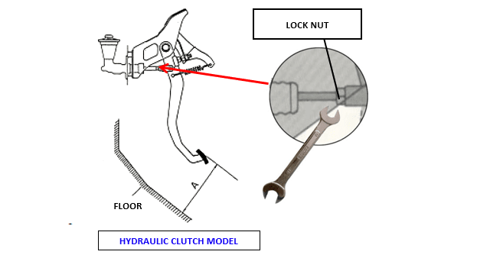
Clutch Adjustment
Notes:
Trainer Note:
Trainer to just tell from Diagram, on adjusting the Clutch by loosening the nut and tighten after adjustment.
Explain about the free play of the clutch pedal.

Slide 63
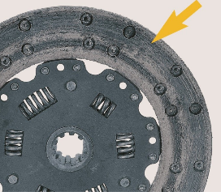
Clutch Trouble Shooting
Clutch Slip: It is experienced when clutch slips while in engagement. It fails to transmit completely the engine torque. Because of slipping , heat is generated due to which clutch facing wear out rapidly/ burns out. This may be caused by:
Incorrect linkage adjustment which causes insufficient ‘free pedal play’. Adjustment of the linkage will remedy this defect.
Oil or grease on friction facing due to leakage from the engine crankcase or the gear box or to excessive lubrication of the clutch shaft and its support bearing. Remedy in this case is to clean the component and replace the clutch facing.
Weak or broken clutch springs. The springs may be overheated, which will be revealed by their blue colour. Over heating reduces spring stiffness and make them weak. In this case the only alternative is to replace the springs.
Worn out facing, which should be replaced.
Notes:
Trainer Note:
1. Trainer to explain on clutch slippage and its remedy

Slide 64
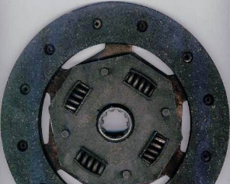
Clutch Trouble Shooting
Clutch Drag/Spin: Sometimes when the clutch is to be disengaged, it is not disengaged completely and it caused difficulty in changing gears. This defect is called clutch drag.
Excessive “free pedal play”. This may have been caused by the driver ‘riding’ the clutch pedal, when the clutch drags, the first thing to be done is to check the ‘free pedal play’
Oil or grease on friction facings. Remedy is to clean the facing if excessively damaged to replace them
Pressure plate warped or damaged. This need replacement
Clutch plate cracked or buckled. The only alternative to remedy this is the replacement of the complete plate.
Clutch plate may be seized on clutch shaft splines. This may be remedied by cleaning up the splines on the shaft and lubricating them.
Notes:
Trainer Note:
1. Trainer to explain on clutch Drag, its causes and how to avoid this.

Slide 65
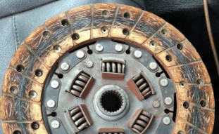
Clutch Trouble Shooting
Clutch Judder: As the clutch is engaged, a vibration or judder is produced instead of smooth engagement & vehicle suddenly jumps forward. The possible causes are:
Loose or worn out clutch facings, which must be replaced.
loose rivets. The whole facing should be replaced.
Distorted clutch plate may also be one of the reasons to cause clutch judder. This has to be replaced
Flywheel may be loose on the crank shaft flange, Tighten to remove the defect.
Misalignment of the pressure plate with the flywheel. This has to be corrected. This requires, however, special equipment.
Bent splined clutch shaft. If the defect is not much, it may be possible to straighten the shaft, otherwise this has to be replaced.
Oil, grease or dirt on the friction surface causing uneven engagement. Friction surfaces on the flywheel & the pressure plate should be cleaned & the clutch facing replaced.
Notes:
Trainer Note:
1. Trainer to explain on Clutch Judder or vibration and how to correct it.

Slide 66
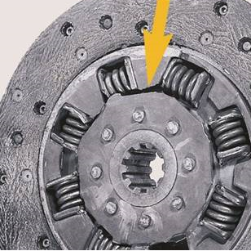
Clutch Trouble Shooting
Clutch Rattle: It is a peculiar & prominent noise observed when the engine is idling.
To locate the cause, press the clutch pedal to take up only the free movement.
If the rattle disappears, it may be due to worn out or loose throw out bearing or it may be that pedal return spring is disconnected and is loose. Replace Bearing or Spring, as applicable.
If the rattle continues, it may be due to damaged clutch plate in which case it has to be replaced.
The bent splined shaft may also be a source of rattle.
Notes:
Trainer Note:
1. Trainer to explain Clutch Rattle and its remedies

Slide 67
Clutch Trouble Shooting
Knock: Observed clearly when the engine is idling and the clutch is engaged.
It may be due to worn out splines of the clutch plate hub or the clutch shaft. Replace defective part either clutch plate hub or clutch shaft or both.
Wearing out of the spigot bearing in the flywheel may also be a cause of knock in the clutch. The bearing will have to be placed in this case.
Pulsation of the clutch pedal: caused by the misalignment of the engine & transmission.
Due to misalignment, clutch disc moves to & fro on the clutch shaft in each revolution, this movement is transmitted back to the pedal. Results in rapid wear of all clutch parts.
Remedy is the proper realignment has to be done.
The pedal pulsation may also be caused by a wobbling flywheel, mostly due to its improper mounting on the engine crank shaft, which may be redone properly.
If the flywheel is otherwise unbalanced the same may be either balanced or replaced.
Notes:
Trainer Note:
Trainer to explain on Knocking its causes and remedy
. Trainer to explain on pulsation of Clutch, its causes and remedy

Slide 68
9. Fan Belt Adjustments

Slide 69
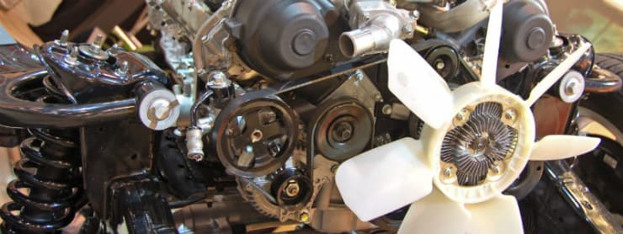
Fan Belt
Fan Belt: also known as a multi-vee, poly-v, or multi-rib belt, is a single, continuous belt used to drive multiple peripheral devices in an automotive engine, such as an alternator, power steering pump, water pump, air conditioning compressor, air pump, etc.
The belt may also be guided by an idler pulley and/or a belt tensioner (which may be spring-loaded, hydraulic, or manual)
Belt
Notes:
Trainer Note:
Trainer to explain on Fan Belt and its requirement in HMV.

Slide 70
Fan Belt Adjustment
Notes:
Trainer Note:
Trainer to explain on how to adjust Fan Belt
Why Fan Belt adjustment is required?

Slide 71
Fan Belt Troubleshooting
Excess noise from the fan belt:
Inspect the belt for misalignment. A common cause of noisy fan belts is a slight misalignment of the belt on the pulleys.
With the hood open, examine the belt to ensure it is mounted on the top most pulley completely straight.
If you are unsure, place a tape measure along the pulley to provide yourself with a frame of reference. If the belt is offset even slightly, it will cause squeaking, squealing or chirping. A belt that is not properly aligned with wear out faster.
Signs of damage / excessive wear: A worn or damaged Fan Belt will become noisy.
Shine a light on the belt and look at it closely. Replace belt for visible cracks or if chunks of belt are missing.
Modern EPDM-made belts are designed to last up to 100,000 miles before being replaced, but may wear prematurely due to misalignment or unusual driving conditions.
Neoprene belts must be replaced every 30,000 to 60,000 miles.
Notes:
Trainer Note:
1. Trainer to tell about signs of Belt damage

Slide 72
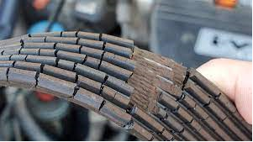



Fan Belt Troubleshooting
Damaged Belt
Damaged Vs New Belt
Notes:
Trainer Note:
1. Trainer to explain the pictures so that candidate understands the difference

Slide 73

Fan Belt Troubleshooting
Locate the tensioner pulley: Latest vehicles come equipped with a tensioner pulley that applies tension to the serpentine or fan belts.
The tensioner pulley is often bolted directly to the engine block and has an opening that will fit a ½ inch drive ratchet.
Replace the tensioner pulley: If the tensioner pulley (or auto tensioner) is too worn out to be able to apply sufficient tension to the belt.
You should not be able to press on the pulley to relieve belt tension by hand. If you are able to, the tensioner must be replaced.
Most tensioners are held in place using only one or two bolts. Remove the old tensioner by removing the bolts passing through it and into the engine block.
Preferably, replace the belt at the same time as loose tensioner may have caused damage to belt.
Notes:
Trainer Note:
1. Trainer to explain on use of Belt tensioner and its trouble shooting.

Slide 74
10. Observation of Dash Board Meters

Slide 75



Instrument Panel / Cluster
Instrument Panel / Cluster: A Panel on which an array of instruments, indicators ,gauges, meters, etc. are mounted to display the condition / performance of the vehicle and also give warning to the driver in case something goes wrong.
New Vehicles are provided with ergonomically designed cluster instrument panel. The instrument panel houses air pressure gauges, oil pressure gauge, water temperature gauge, fuel gauge, ammeter / voltmeter, speedometer & engine rpm meter, battery charge indicator, low oil pressure warning light, parking brake indicator, head lamp indicator & LH/RH directional indicators, etc.
One should maintain the wiring Harness & cables and DO NOT CUT them under any circumstances.
No scratches on Dash board Glass recommend.
Keep the Dash board clear of any object, which restricts view.
Notes:
Trainer Note:
To explain on major issues on particular light glowing – very briefly
Trainer to explain dos & donts for keepin Instrument panel clean and always visible.

Slide 76

Instrument Panel / Cluster Typical layout
SET Button
MODE Button
Notes:
Trainer Note:
1. Trainer to tell on addition of Indicators in BS6 Vehicle Instrument Panels

Slide 77

Instrument Panel / Cluster
Notes:
Trainer Note:
Trainer to tell on various indications and important / critical ones

Slide 78

Instrument Panel / Cluster
Understanding the Dashboard
Notes:
Trainer Note:
1. Trainer to tell briefly on various indicators

Slide 79
Instrument Panel / Cluster
Typical Instrument Panel
Notes:
Trainer Note:
1. Trainer to explain briefly on typical BS3/BS4 Instrument panel

Slide 80
Instrument Cluster
1. Air pressure gauge.
2. Oil pressure gauge.
3. Speedometer with trip meter.
4. RPM meter.
5. Volt meter.
6. Air restriction indicator.
10. Tipping Valve.
(For Haulage Tipper)
11. Ignition switch.
12. Fuel gauge.
13. Head lamp switch.
14. Temperature gauge.
15. Head lamp levelling switch.
16. Hazard warning switch.
17. ABS switch. (For Tractors)
18. Differential lock switch. (For 6x4)
19. PTO engagement switch. (MAV Tipper)
20. Trip meter reset knob.
21. Simplified trip computer knob. (Optional)
Notes:
Trainer Note:
1. Duplicate slide for better understanding as markings written separately

Slide 81
Instrument Cluster
Notes:
Trainer Note:
1. AL BS3/4 Instrument Cluster - duplicate

Slide 82


Instrument Panel / Cluster
Dash Board Meters
Notes:
Trainer Note:
1 Trainer to explain on various dashboard Meters
1. What is the output of various Meters?

Slide 83

Instrument Panel / Cluster
Dash Board Meters
Notes:
Trainer Note:
1 Trainer to explain on various dashboard Meters in slide
1. What is the output of various Meters?

Slide 84

Instrument Panel / Cluster
Dash Board Meters
Notes:
Trainer Note:
1 Trainer to explain on various dashboard Meters in slide
1. What is the output of various Meters?

Slide 85



Instrument Panel / Cluster
Dash Board Meters
Notes:
Trainer Note:
1. Trainer to explain on various meters shown in slide

Slide 86
11.Lubrication

Slide 87

Lubrication System
The purpose of lubrication system is to supply the lubricating oil between the moving parts of the engine in order to reduce the friction, Provide the cooling effect, Carry away the deposits formed due to wear and tear.
The function of the lubrication system
reduce the friction between the two mating surfaces
to reduce wear and tear
seal high pressure gases
to take away heat from hot areas
The main components
Oil Pump, Oil Filter
Main Gallery, Oil sump
Notes:
Trainer Note:
Trainer to explain what is lubrication & its functions.

Slide 88

Lubrication System - Maintenance
Maintenance: Motor oil is a lubricant used in internal combustion engines, which power Vehicles, motorcycles, lawnmowers, engine-generators, and many other machines.
Lubricating oil creates a separating film between surfaces of adjacent moving parts to minimize direct contact between them, decreasing heat caused by friction and reducing wear, thus protecting the engine.
The oil and the oil filter need to be periodically replaced.
The oil filter removes many of the particles and sludge, but eventually oil filter can become clogged, if used beyond recommended life as fixed by OE manufacturer
Motor oil changes are usually scheduled based on the time in service or the distance that the vehicle has travelled.
Notes:
Trainer Note:
Trainer to explain why maintenance is Required.
Trainer to stress on why to USE ONLY OEM Recommended Lube Oils.

Slide 89


Lubrication System - Maintenance
Maintenance Tips:
Use only genuine and recommended brand oils for different aggregates.
Replace the oil filters , wherever necessary, as per the maintenance schedule.
Follow the manufacturer’s recommended oil change frequency.
Do not mix up the oils of different aggregates.
Don’t use the drained oil for lubrication purposes.
Use only recommended grade of oils, fluids and greases.
Use greasing guns for better and proper greasing of joints, linkages etc.
Don’t Mix up oil and grease together for lubrication purposes.
While draining the oils, keep the vehicle on a levelled surface.
Don’t drain the oils in ‘cold’ condition of aggregates.
Notes:
Trainer Note:
Trainer to give maintenance tips

Slide 90
Lubrication System – Sample Consumable change Recommendation
Notes:
Trainer Note:
1. Trainer to show a sample of recommended Various Oil change Chart.

Slide 91
12.Removal of Air Lock

Slide 92

Removal of Air Lock
Air Lock: It is a restriction of, or complete stoppage of liquid flow caused by vapour trapped in a high point of a liquid-filled pipe system.
Air locks are caused by air leaking into the fuel delivery line or entering from the tank.
Air locks are eliminated by turning the engine over for a time using the starter motor, or by bleeding the fuel system. Modern diesel injection systems have self-bleeding electric pumps which eliminate the air lock problem.
Notes:
Trainer Note:
1. Trainer to explain on What id Air lock and give inputs on how it happens.

Slide 93

Removal of Air Lock
How to Bleed a Diesel Engine:
Close the bleed screw on the filter. Locate all of the remaining bleed screws on the fuel lines, fuel filters, and the fuel pump.
Open the screw that is closest to the gas tank, and follow the same bleeding process. Continue to bleed one component at a time, working your way out from the fuel tank.
Close bleed plugs after all air is removed from the fuel tank, filters, settlement bulb, and fuel pump (only one at a time working through all bleed screws beginning closest to tank and ending at nozzles if necessary).
Try the engine; if it doesn't start or runs poorly, you may have to bleed the injection line.
Notes:
Trainer Note:
1. Trainer to explain on Bleeding of Diesel Engine

Slide 94
Removal of Air Lock
Bleeding Procedure – Fuel Lines
Ensure that
1. Adequate diesel is available in fuel tank.
2. There are no damaged fuel pipes.
3. The copper washer below the priming hand pump must be ok, otherwise
priming takes more time due to entry of air and hence bleeding is not proper.
4. The pipe fittings are tight.
5. The suction strainer in fuel tank is clean.
6. Both the fuel filters and their seals are in good condition.
7. The filter in the banjo bolt on feed pump suction pipe is clean
a) Pump the plunger on feed pump and ensure that air free diesel flow
occurs at the filter bleeding screw.
b) Start the engine
Notes:
Trainer Note:
1. Trainer to explain the procedure on Bleeding, with mention on how to air lock removal in inline and Electronic FIP

Slide 95
Thank you

